Slide 1
CMDA 3654 Final Project:
College Football Statistics
Trevor Senior, Kyle Parker and Fernando Oliveros

Slide 2
Executive Summary
Motivation behind project
Learn more about college football
Goals
Test common myths (Home vs. Visit)
Predict the margin of victory
Results
Proves some myths true
Decent margin of victory prediction
Notes:
Assignment:
Executive Summary (Motivation behind project, goals + results)

Slide 3
Data Sources
The Sunshine Forecast
http://www.repole.com/sun4cast/data.html
Format
CSV & XML
21 variables
1515 entries
Notes:
Assignment:
Presentation of Data and Data sources (what variables, how they are measured, what type,
where they are coming from)
Notes:
From The Sunshine Forecast
“
Warren Repole first published his newsletter The Sunshine Forecast in 1984. Focusing exclusively on football with selections based on computer power ratings and historical angles, Warren earned the 3rd most top 10 football rankings (58) for handicappers monitored by Sports Watch from 1993 to 2004.
His database of historical football information is now available on this Web site.
“

Slide 4
Data Sources
# | Name | Type | Description
1 | Date | String | Date of game
2 | TeamName | String | Offensive Team
3 | ScoreOff | Int | Offensive Points Scored
4 | RushAttOff | Int | Offensive Rushes Attempted
5 | RushYdsOff | Int | Offensive Rush Yards
6 | PassAttOff | Int | Offensive Passes Attempted
7 | PassCompOff | Int | Offensive Passes Completed
Notes:
Assignment:
Presentation of Data and Data sources (what variables, how they are measured, what type,
where they are coming from)
Variables:
Date TeamName ScoreOff RushAttOff
RushYdsOff PassAttOff PassCompOff PassYdsOff
PassIntOff FumblesOff Opponent ScoreDef
RushAttDef RushYdsDef PassAttDef PassCompDef
PassYdsDef PassIntDef FumblesDef Site Line
Notes:
From The Sunshine Forecast
“
Warren Repole first published his newsletter The Sunshine Forecast in 1984. Focusing exclusively on football with selections based on computer power ratings and historical angles, Warren earned the 3rd most top 10 football rankings (58) for handicappers monitored by Sports Watch from 1993 to 2004.
His database of historical football information is now available on this Web site.
“

Slide 5
Data Sources
# | Name | Type | Description
8 | PassYdsOff | Int | Offensive Passing Yards
9 | PassIntOff | Int | Offensive Pass Interceptions
10 | FumblesOff | Int | Offensive Fumbles
11 | Opponent | String | The name of the opponent team
12 | ScoreDef | Int | Defensive Score
13 | RushAttDef | Int | Defensive Rushes Attempted
14 | RushYdsDef | Int | Defensive Rush Yards
Notes:
Assignment:
Presentation of Data and Data sources (what variables, how they are measured, what type,
where they are coming from)
Variables:
Date TeamName ScoreOff RushAttOff
RushYdsOff PassAttOff PassCompOff PassYdsOff
PassIntOff FumblesOff Opponent ScoreDef
RushAttDef RushYdsDef PassAttDef PassCompDef
PassYdsDef PassIntDef FumblesDef Site Line
Notes:
From The Sunshine Forecast
“
Warren Repole first published his newsletter The Sunshine Forecast in 1984. Focusing exclusively on football with selections based on computer power ratings and historical angles, Warren earned the 3rd most top 10 football rankings (58) for handicappers monitored by Sports Watch from 1993 to 2004.
His database of historical football information is now available on this Web site.
“

Slide 6
Data Sources
# | Name | Type | Description
15 | PassAttDef | Int | Defensive Attempted Passes
16 | PassCompDef | Int | Defensive Pass Completions
17 | PassYdsDef | Int | Defensive Pass Yards
18 | PassIntDef | Int | Defensive Pass Interceptions
19 | FumblesDef | Int | Defensive Fumbles
20 | Site | Char | H, V, N = Home, Visiting, Neutral
21 | Line | Double | Betting Line
Notes:
Assignment:
Presentation of Data and Data sources (what variables, how they are measured, what type,
where they are coming from)
Variables:
Date TeamName ScoreOff RushAttOff
RushYdsOff PassAttOff PassCompOff PassYdsOff
PassIntOff FumblesOff Opponent ScoreDef
RushAttDef RushYdsDef PassAttDef PassCompDef
PassYdsDef PassIntDef FumblesDef Site Line
Notes:
From The Sunshine Forecast
“
Warren Repole first published his newsletter The Sunshine Forecast in 1984. Focusing exclusively on football with selections based on computer power ratings and historical angles, Warren earned the 3rd most top 10 football rankings (58) for handicappers monitored by Sports Watch from 1993 to 2004.
His database of historical football information is now available on this Web site.
“

Slide 7
Presentation of Data
Variables
Bivariate data
Qualitative, quantitative (discrete)
How they are measured
Nominal (e.g. Home, Visiting, Neutral)
Ordinal (e.g. Line)
Ratio (e.g. Score)
Notes:
Assignment:
Presentation of Data and Data sources (what variables, how they are measured, what type,
where they are coming from)
Notes:
Qualitative variables take on values that are names or labels.
Quantitative variables are numeric.
Discrete variable’s don’t have a defined min and max value.
___
Bivariate data
When we conduct a study that examines the relationship between two variables, we are working with bivariate data.
___
http://www.upa.pdx.edu/IOA/newsom/pa551/lecture1.htm
Nominal
A variable measured on a "nominal" scale is a variable that does not really have any evaluative distinction.
Ordinal
Something measured on an "ordinal" scale does have an evaluative connotation. One value is greater or larger or better than the other.
Ratio
Something measured on a ratio scale has the same properties that an interval scale has except, with a ratio scaling, there is an absolute zero point. Temperature measured in Kelvin is an example. There is no value possible below 0 degrees Kelvin, it is absolute zero.

Slide 8
Numerical Summaries
Variable | Mean | Standard deviation
ScoreOff | 29.51 | 15.44
RushAttOff | 39.37 | 10.11
RushYdsOff | 176.1 | 94.97
PassAttOff | 32.45 | 10.98
Notes:
Assignment:
Discussion of data analytics and interpretations (numerical summaries)
___
ScoreOff - Mean: 29.51
RushAttOff - Mean: 39.37
RushYdsOff - Mean: 176.1
PassAttOff - Mean: 32.45
PassCompOff - Mean: 19.36
PassYdsOff - Mean: 236.2

Slide 9
Numerical Summaries
Variable | Mean | Standard Deviation
PassCompOff | 19.36 | 7.72
PassYdsOff | 236.2 | 98.11
PassIntOff | 0.9518 | 0.9980
FumblesOff | 0.7307 | 0.8422
Notes:
Assignment:
Discussion of data analytics and interpretations (numerical summaries)
___

Slide 10
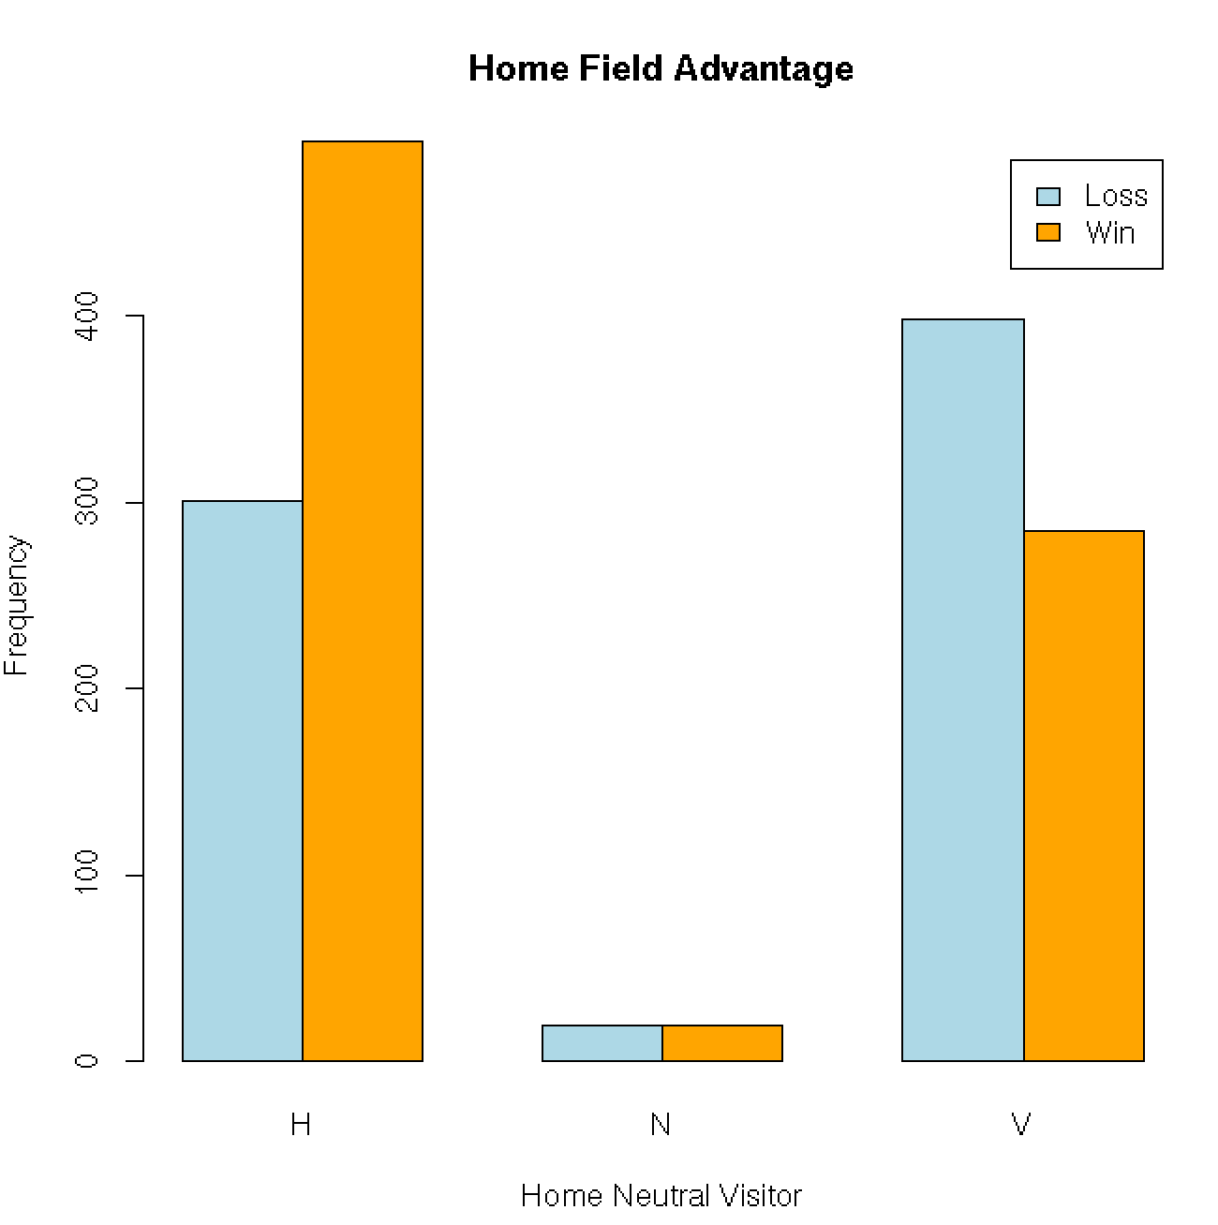
Notes:
Summary:
When teams play on their home field, they tend to win more

Slide 11
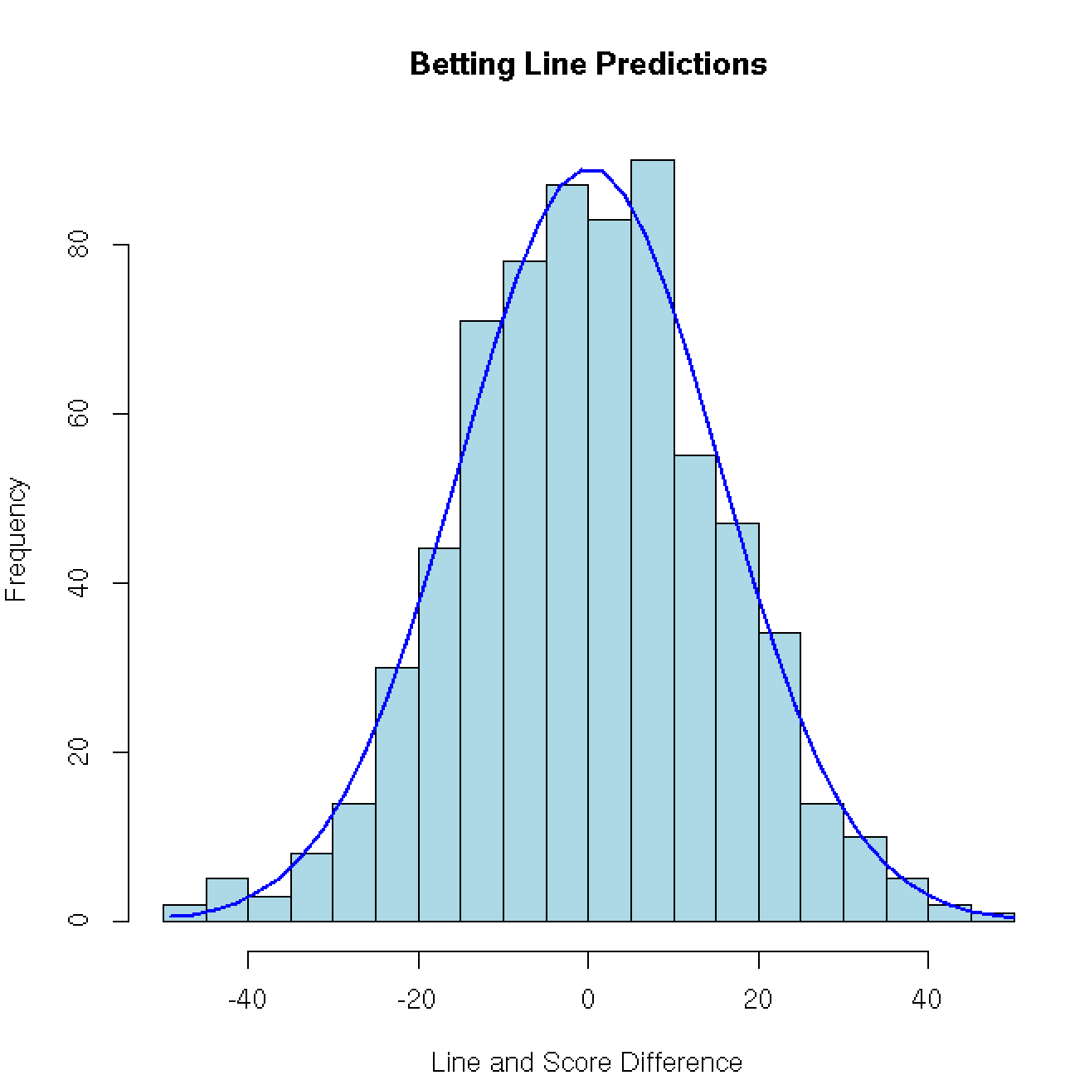
Notes:
Summary:

Slide 12
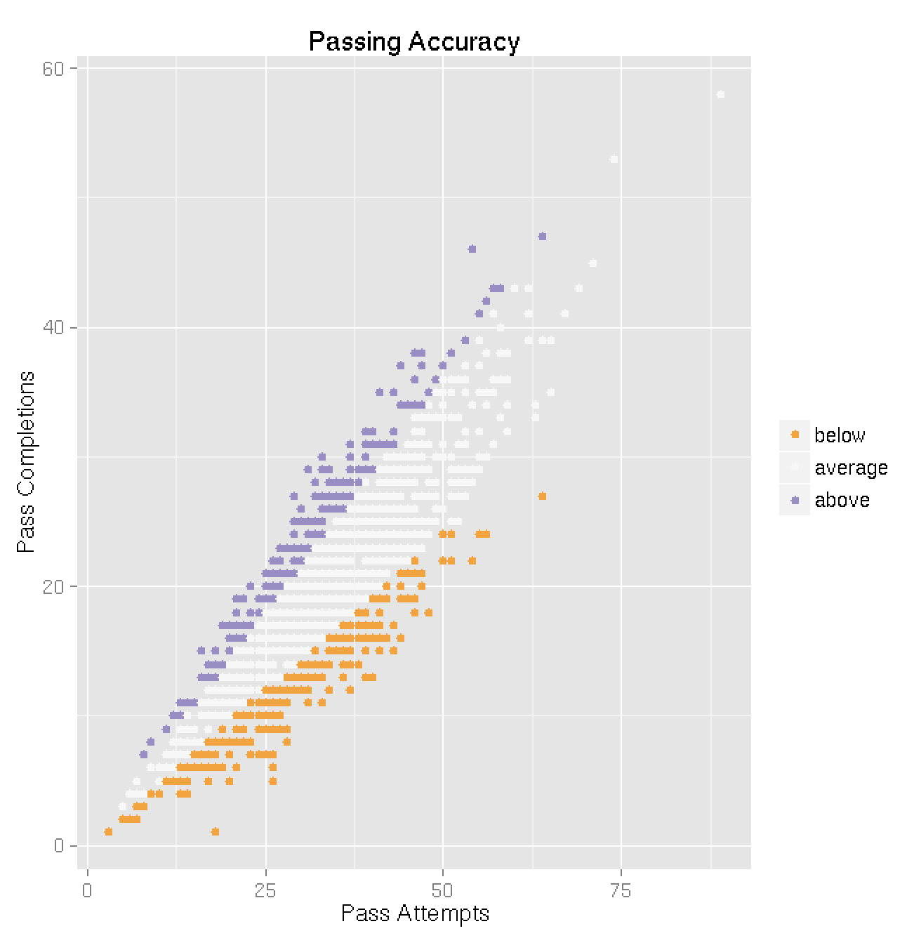
Notes:
Summary:
The passing accuracy of the teams. Could we divide the colos by standard deviation? woule be something we could point out to look gewd
alright, now uses .48 & .72 so should

Slide 13
Machine Learning
Algorithm
Stepwise regression
Effective when taking into account numerous variables
Site and rush attempts found to be insignificant
How it works
Stepwise regression is used to select a subset of variables, then linear regression is used for the model
Notes:
Assignment:
Machine learning algorithm employed, and how it works
___

Slide 14
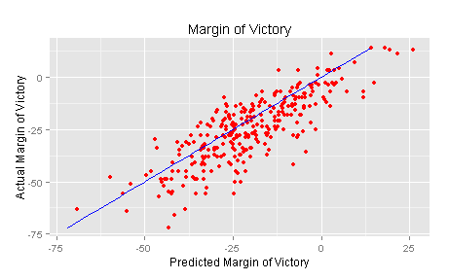
Machine Learning
The model tended to be more conservative than actual results
Standard error of 8.988
R-squared of 0.8242
Notes:
Assignment:
ML algorithm results and validation
___

Slide 15
Conclusions & Recommendations
Final results
Betting line is accurate, home field advantage is true, and stepwise regression ML algorithm is passable
It is very difficult to create a computer prediction model for college football in particular
Improvements
Sample size. Entire season as train data, post-season for test data.
Notes:
Assignment:
Conclusions and recommendations for deployment
___

Slide 16
Notes:
END BLANK SLIDE. Keep this so we don’t accidentally exit the powerpoint!!

